Slide 1

The best Neighborhood for students in New York

Slide 2
Problem Statement
Choosing a place to live while studying can be a very complicated and exhausting task, as we must consider not only the cost and location but also if there are supermarkets, coffee shops, laundries and other establishments that we need almost daily. The purpose of this project is to present the best neighborhoods for students in New York considering these establishments and then the student will be able to choose where to live looking at a good neighborhood near his campus

Slide 3
Data
A dataset that contains the 5 borough and the neighborhoods that exist in each borough as well as the latitude and longitude coordinates of each neighborhood
Geopy coordinate for obtain the latitude and longitude of New York
Foursquare data to collect top 100 venues

Slide 4
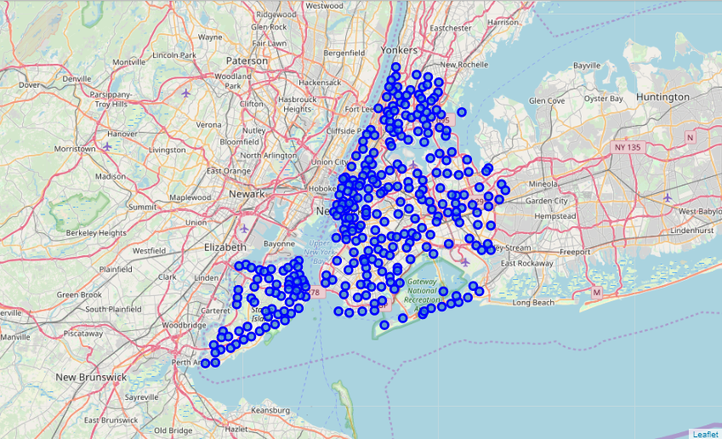
Map of the neighborhoods

Slide 5
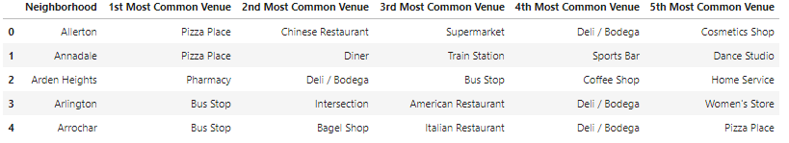
The neighborhoods and their most common venues
This is the top 5 of 306 venues

Slide 6
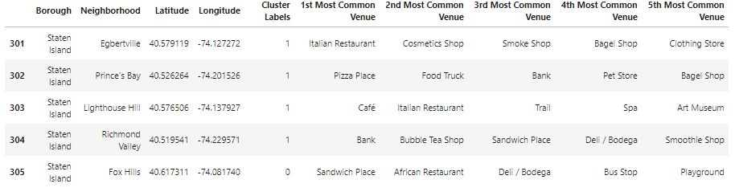
Clusters
Then we clustered the neighborhoods and labeled them based on how similar or different they are

Slide 7
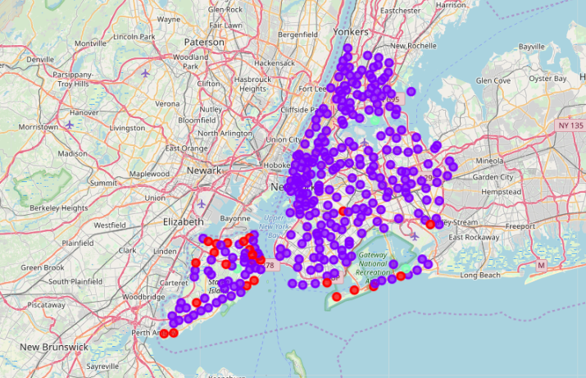
Map of the neighborhoods, now based on each cluster

Slide 8
Conclusion
As we can see, the most part of the neighborhoods offer all the basic needs and comodities that a student need. There are just a few neighborhoods that aren’t recommended because they offer different types of services close by or because don’t have enough services near the location

